Slide 1

6+++++
Epidemiology of Candida auris
in Missouri

Slide 2
First Detection of Candida auris (C. auris) in Missouri
Identified in late 2020 in an Acute Care Hospital.
Patient had previous health care in Washington DC area, a known high incidence area.
Screening was conducted at that time, no additional cases identified.

Slide 3
First Identified Missouri Transmission
In October 2023, a patient in a Long-Term Care Facility tested positive on colonization screening.
Patient had no history of health care outside of Missouri or known travel history.
Colonization screening was conducted based on previous detection of another multi-drug resistant organism (MDRO).

Slide 4
C. auris in Missouri
Since October 2023 there have been 8 patients identified in Missouri health care facilities.
*23 Q4 Data as of 12/13/2023
Case counts do not include C. auris positive patient that were identified in other states that may have received health care in Missouri

Slide 5
C. auris
All 7 isolates from 6 patients that have been sequenced with Whole Genome Sequencing (WGS) have been identified as Clade IV.
Positive specimens have included blood, bile, wound, and axilla/groin.
Recent patients have been identified in multiple facility types including Acute Care Hospital and Long-Term Care Facilities.
Notes:
Currently only 1 wound has been positive for C. auris.

Slide 6
Patient Demographics
Patient age ranges between 36 - 83 years, median age of 67 years.
4 of 10 have known history of health care in high incidence areas.
All 10 patients are identified as male.
All 10 patients have history of multiple health care facilities in prior 12 months to detection.
All 10 patients are considered high risk.

Slide 7
Patient Health Risk Factors
6 of 10 have history of invasive medical devices.
7 of 10 patients are diagnosed with diabetes.
2 of 10 patients were receiving dialysis, both with known arteriovenous fistulas.
2 of 10 have known history of another MDRO.
5 of 10 of the patient have wounds.
Notes:
Currently only 1 wound has been positive for C. auris.

Slide 8
Transmission
Increased identification of C. auris has been reported in other midwestern states, including Illinois.
Currently there is no single link between the 8 recently identified cases.
Transmission is suspected to have occurred between roommates in a health care facility.

Slide 9
HAI/AR Response
Screening
  Screening is available to impacted facilities, even if patient is no longer at facility.
  Screening is done using axilla / groin swabs.
Infection Control Assessment and Response (ICAR)
  A non-regulatory site visit designed to compare facility practices to CDC best practices with written feedback provided.

Slide 10
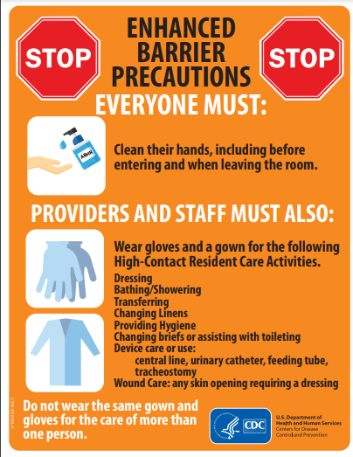
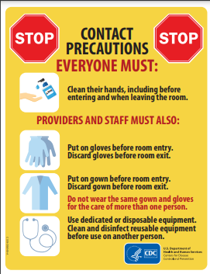
Transmission Based Precautions
Enhanced Barrier Precautions
Contact Precautions
Gown and Glove Use with High Contact activities (face covering if expecting splash)
Used with Positive Patient AND High Risk Patients
ONLY USED IN LTCF/SNF
Does not require room restriction/ Patient is allowed to have Roommate
Gown and Glove use with every room/ patient area entry
Used with positive patient
Used in hospitals and dialysis centers
Requires room restriction, no roommates, some facilities may restrict visitors

Slide 11
Environmental Cleaning
Ensure all areas are being cleaned routinely, including high touch surfaces (bed rails, doorknobs, sinks, toilets, computers, etc.) with effective disinfectant.
Check labels/ with manufacturers on disinfectants for kill claims and contact times. Always double check!!
C. auris is somewhat limited on effective disinfectants.
  See EPA List P.

